Slide 1


Super Vandal World
MVP and Status Update
Members:
Ben: IT Manger
Justin: Software Architect
Heba: Quality Assurance Manger
Davey: Project Manger
John: AI Specialist
Keller: Version Control Manager

Slide 2
Feature Breakdowns

Slide 3
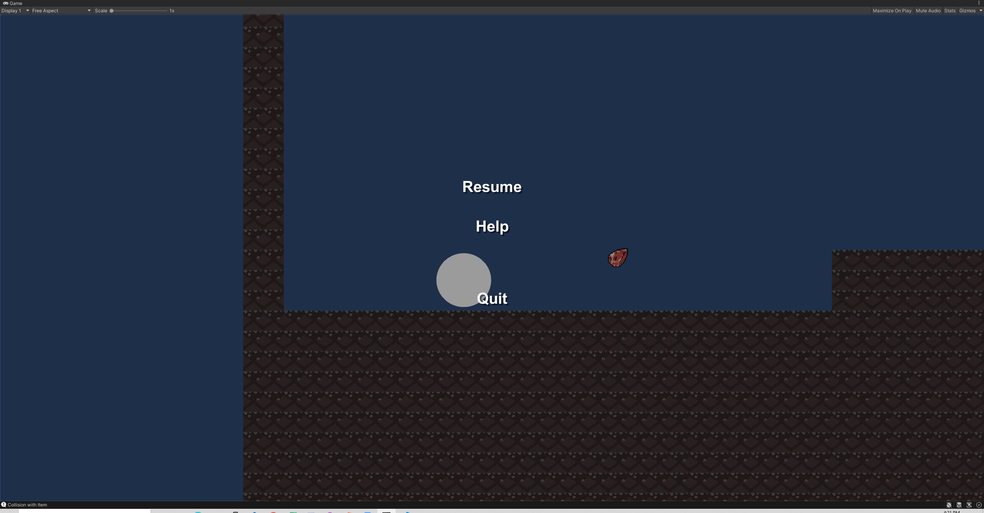
Ben: Pause Menu / Sound Manager
Script:
PauseMenu.cs
SoundManager.cs
Function Name:
void Start()
Sets time to real time
Finds Pause Menu object
Calls hidePaused()
void Update()
Checks for Esc key input
Sets time to paused and calls showPaused() if in real time
Sets time to real time and calls hidePaused() if time is paused
public void pauseControl()
Hides the Pause Menu if the Resume Button is pressed and sets time to real time
Controls the overall time-state of the game
public void showPaused()
Enables the Pause Menu objects
public void hidePaused()
Disables the Pause Menu objects
public void LoadLevel(sting level)
Not currently implemented
Loads a level based on an input
public void HelpMenu()
Prints a message to the console
public void QuitMenu()
Prints a message to the console
Quits the game

Slide 4
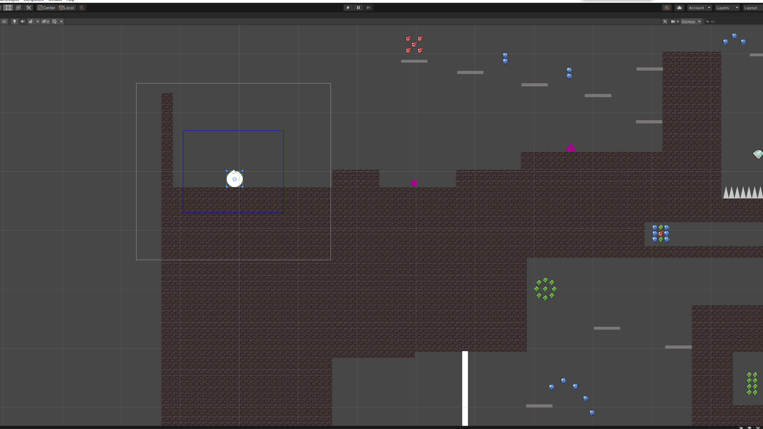
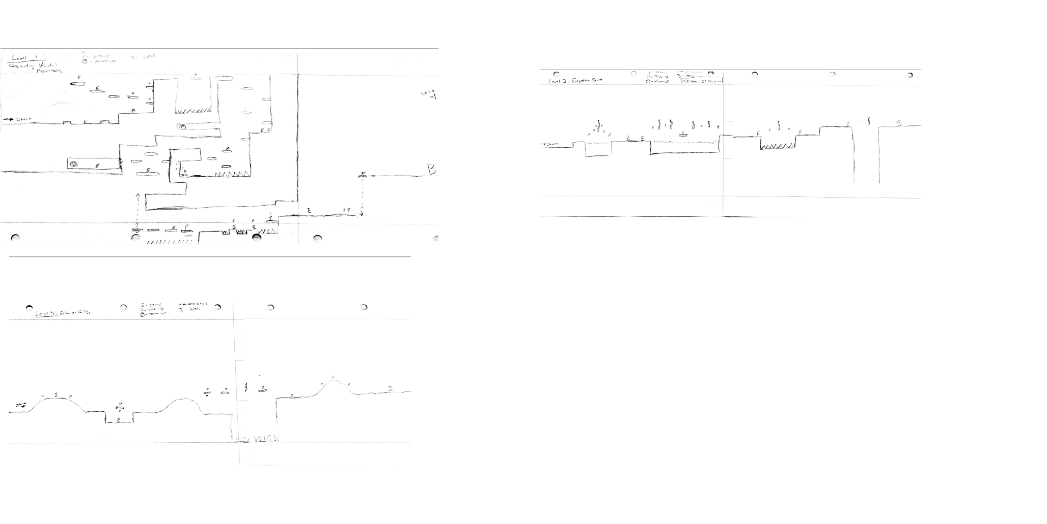
Justin: Generate Camera
Scripts:
CameraFollow.cs
Function Name:
public void followPlayer()
Adjust camera position based on player movement
Sets speed of the camera
void Start()
Initializes Camera threshold
Sets the Player as the object for the camera to follow
FixedUpdate()
Calls followPlayer()
void OnDrawGizmos()
Draws a visible box of the camera threshold
Calls calculateThreshold()
Vector3 calculateThreshold()
Sets boundaries for camera threshold
Level Designs:

Slide 5
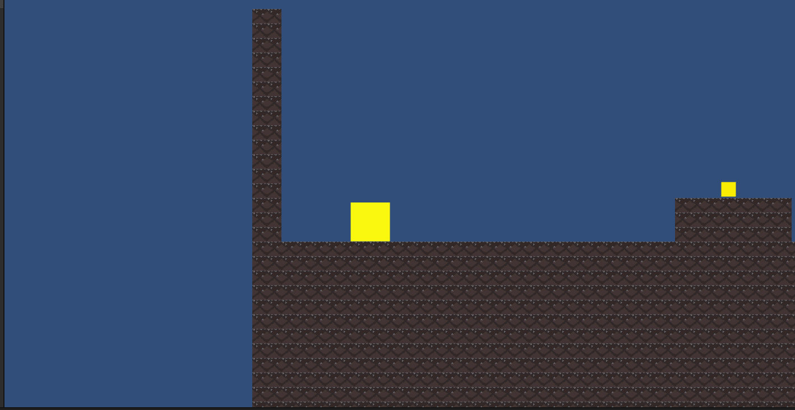
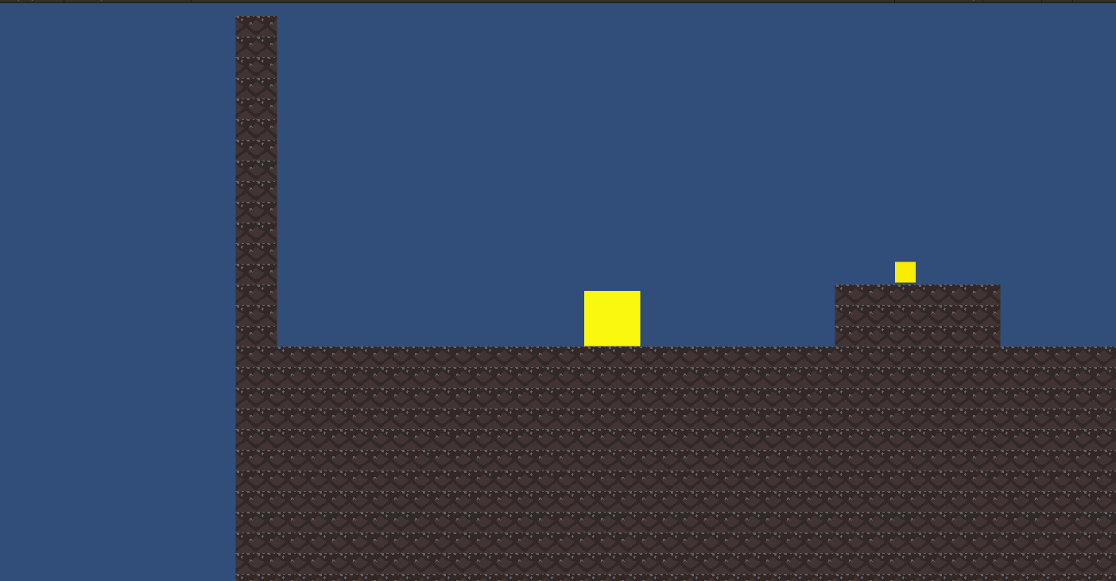
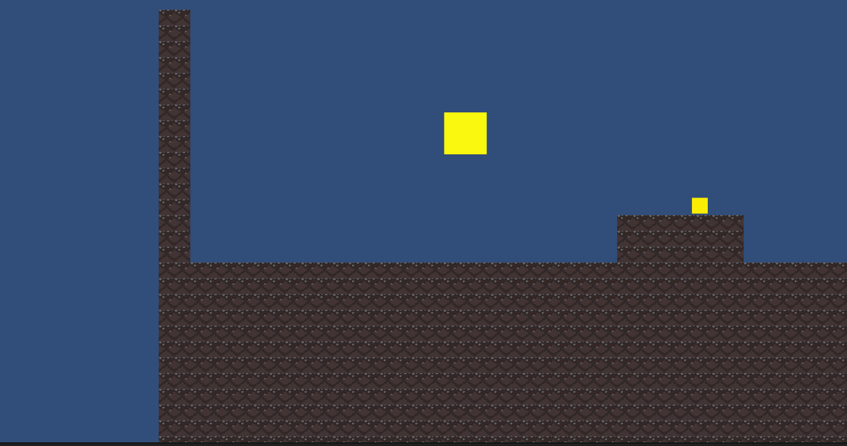
John: Character Movement
Script:
Character_Movement.cs
Function Name:
void Start()
Initializes variables to the player’s rb and collider
void Update()
Sets Left and Right controls
Sets speed of the player
Checks for Spacebar being pressed
Calls CheckIfGrounded()
CheckIfGrounded()
Checks if player is currently on a “Ground” layer
Returns null if not on “Ground”

Slide 6
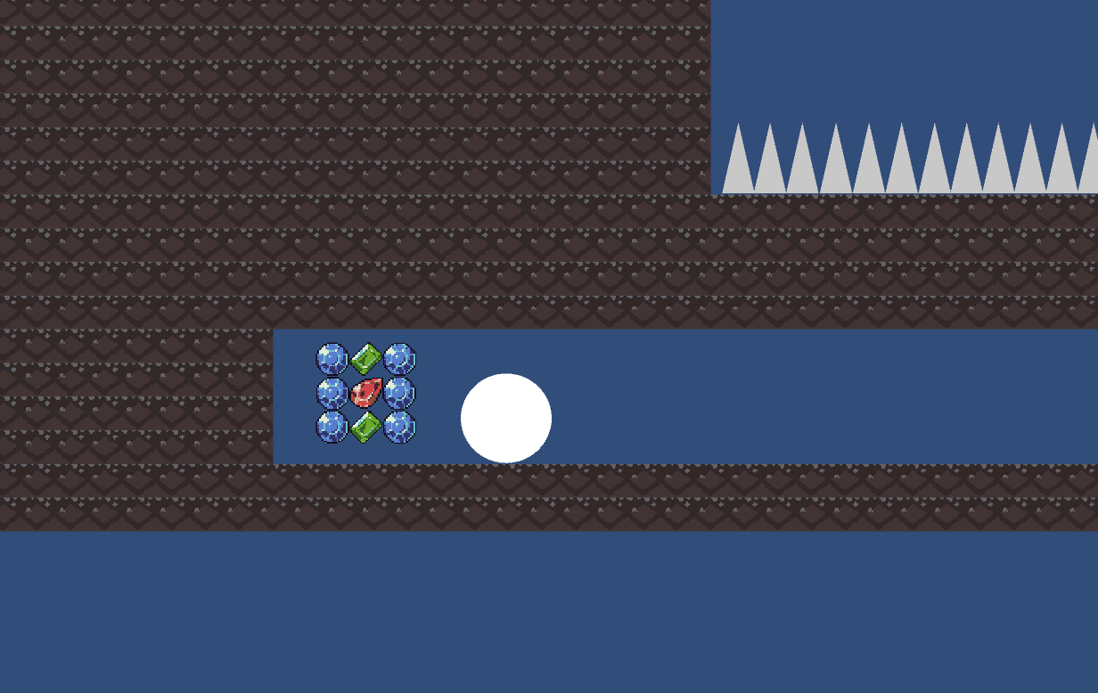
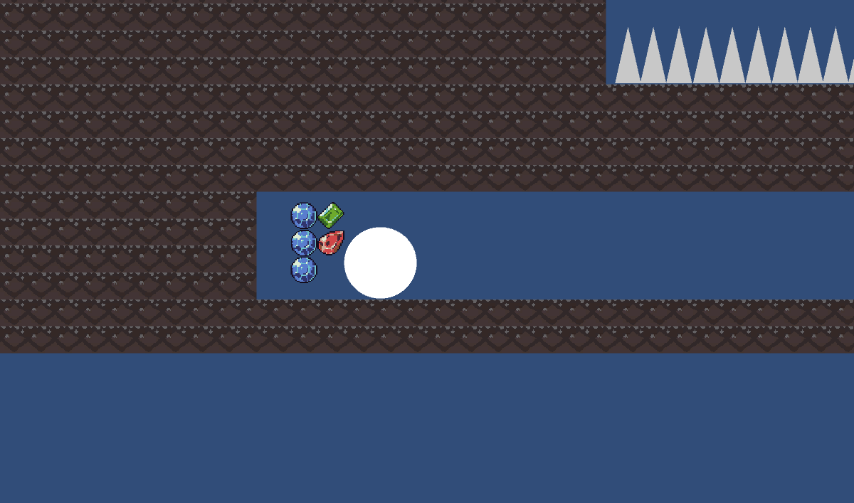
Keller: Pick-ups
Scripts:
PickupsManager.cs
Items.cs
PowerUps.cs
Function Name(s):
void OnTriggerEnter2D(Collider2D other)
Compares tags
Calls function in child class
public static void removeAsset(Collider2D other)
Called in the child class
Removes item from scene

Slide 7
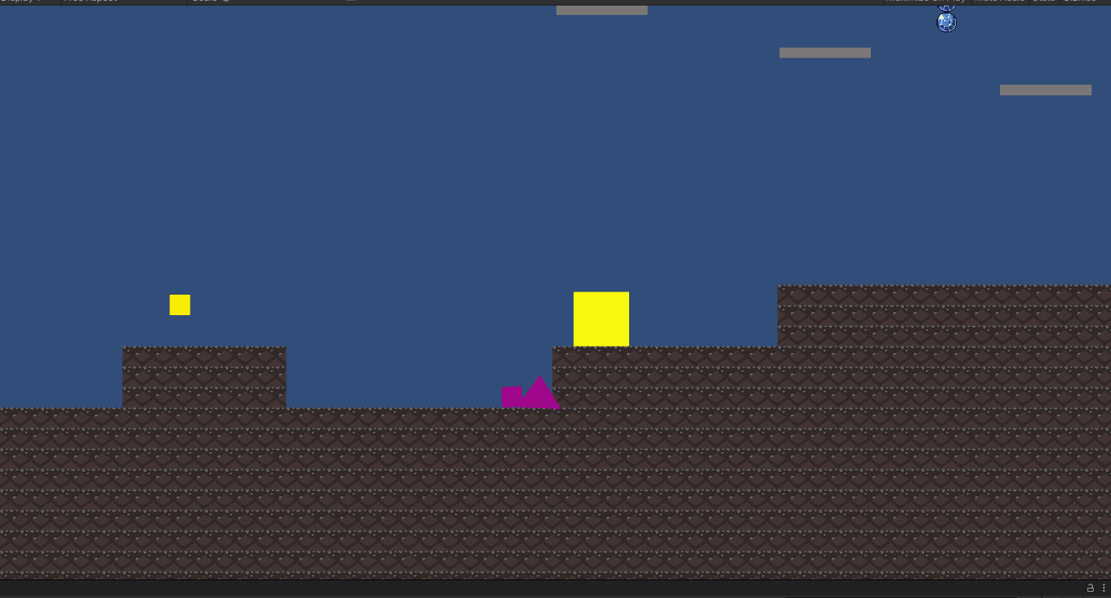
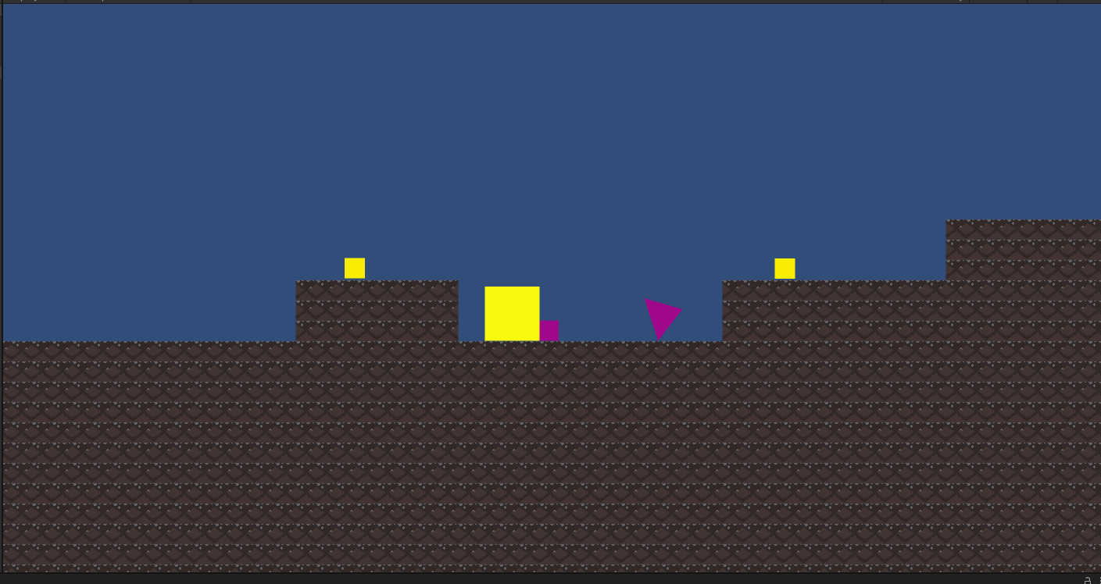
Davey: Enemy Controller
Script:
EnemyController.cs
Function Name:
void Update()
Checks if enemy is in scene (not fully implemented)
Prints a message to the console
Sets up enemy speed
Sets enemies to get player location and travel toward the player

Slide 8
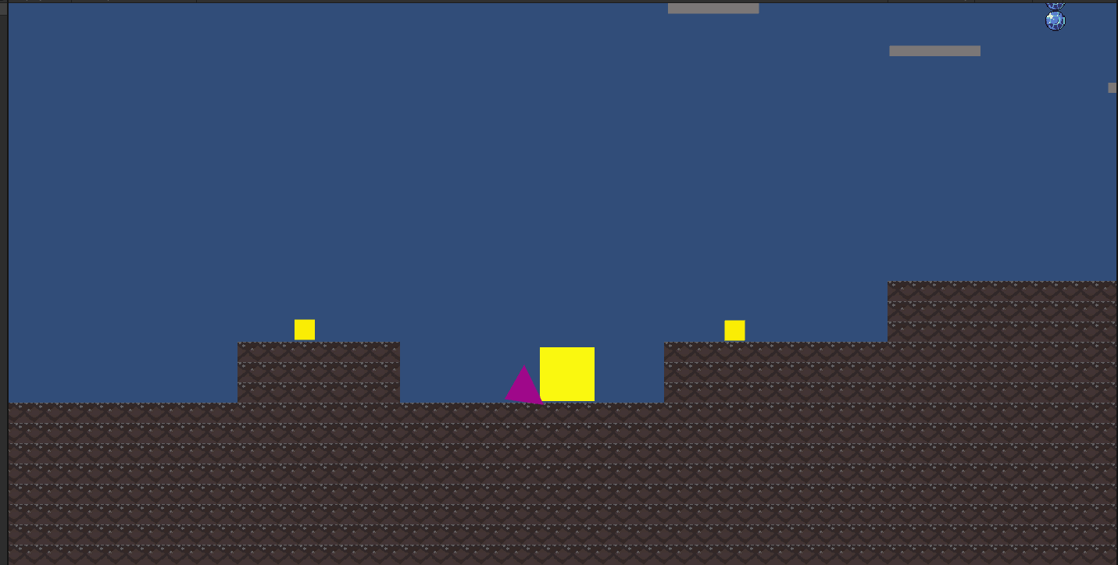
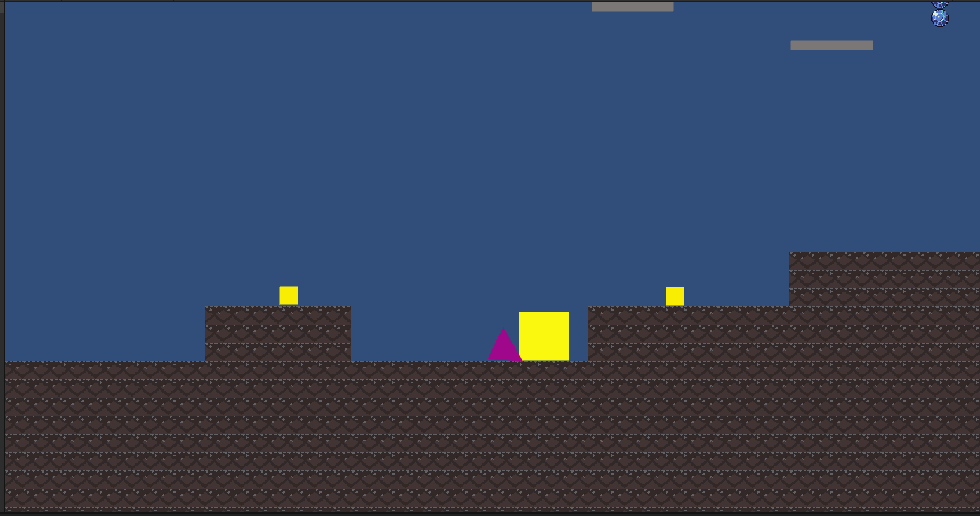
Heba: Enemy Movement
Script Name:
Square
Function Name:
void Start()
Sets RigidBodies to a variable
void Update()
Sets enemies to move according to a specified time – currently 2 seconds
void FixedUpdate()
Implements the enemy movement

Slide 9
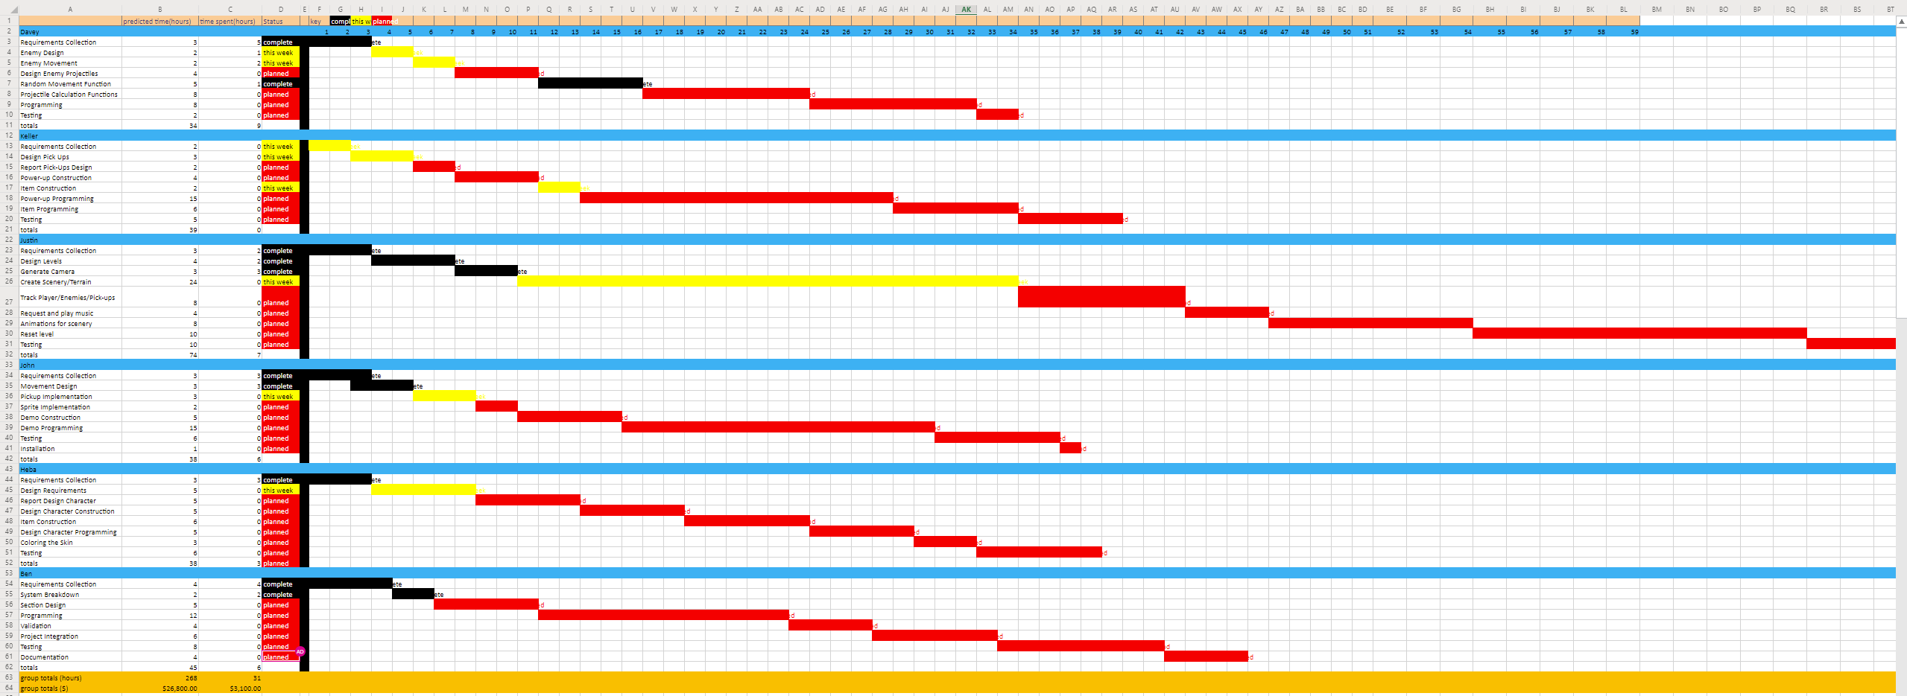
Timeline Update
Completed:
Ben: Req. Collection, System Breakdown
Justin: Req. Collection, Generate Camera, Level Design
John: Req. Collection, Movement Design
Keller: Req. Collection
Davey: Req. Collection, Random Movement Function
Heba: Req. Collection
Working On:
Ben: Section Design
Justin: Create Scenery/Terrain
John: Pick-up Implementation
Keller: Pick-up Design, Pick-up Construction
Davey: Enemy Design, Enemy Movement
Heba: Design Req.
https://vandalsuidaho-my.sharepoint.com/:x:/g/personal/angu7936_vandals_uidaho_edu/ESwW7DUrar5Btsyqpne1lZoB-VRVyVAlue0cf-k1a9rLpg?rtime=xIWUCYJl2Eg

Slide 10
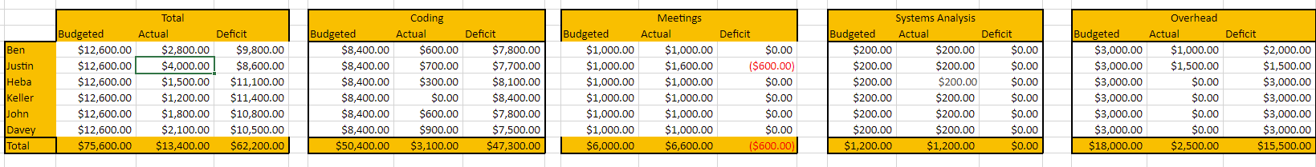
Budget Update

Slide 11
Questions?

